Slide 1
Git and GitHub

Slide 2
What is Git:
Git is a version control system that helps you keep track of changes made to files and collaborate with others on projects. It allows you to save different versions of your work, compare changes, and merge them together. Git is commonly used in software development to manage code, but it can also be used for other types of files such as documents or graphics.
Alright, imagine you're drawing a picture on a piece of paper with your friends. Git is like magic paper that remembers every picture you draw and every change you make to the picture. So, if you want to go back to an older picture or see who drew what, Git helps you do that. It's like having a super smart notebook for your drawings!

Slide 3
What is GitHub then ?
GitHub is a website and platform where people can store their Git repositories (remember, Git helps you keep track of changes in your files). It's like a big online community centre where people can share their projects, collaborate with others, and contribute to open-source projects. GitHub makes it easier for developers to work together on software projects by providing tools for communication, issue tracking, and code review. It's a hub for coding collaboration!

Slide 4

Features in GitHub:
Repositories
Collaboration Tools (Pull Requests, Issues, Project Boards)
Branching and Merging
Community and Social Features
Continuous Integration and Deployment (CI/CD)
Security Features
Documentation and Wikis
Analytics and Insights
GitHub Pages(Beta)

Slide 5
Getting Started with Git and GitHub
Prerequisites:
A GitHub account
Git
Stable Internet Connection
Browser (Chrome,Safari,Edge...whatever)
GitHub Desktop app(Optional)
That's it!!!

Slide 6
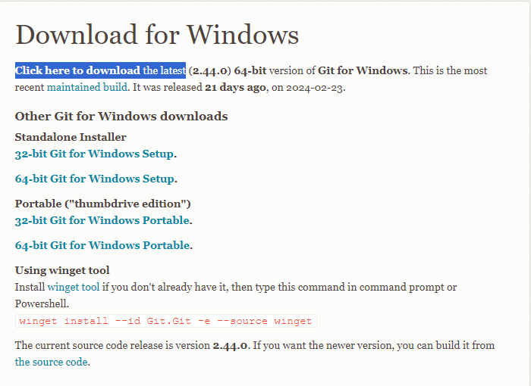
Step 1 : Install Git
Go to https://git-scm.com/download/win
And click "Click here to download the latest"
Download the installer
Follow the instructions
Set everything to default and install
Refer to https://youtu.be/Ez8F0nW6S-w?si=ywULRJal1MYM5Qdp

Slide 7
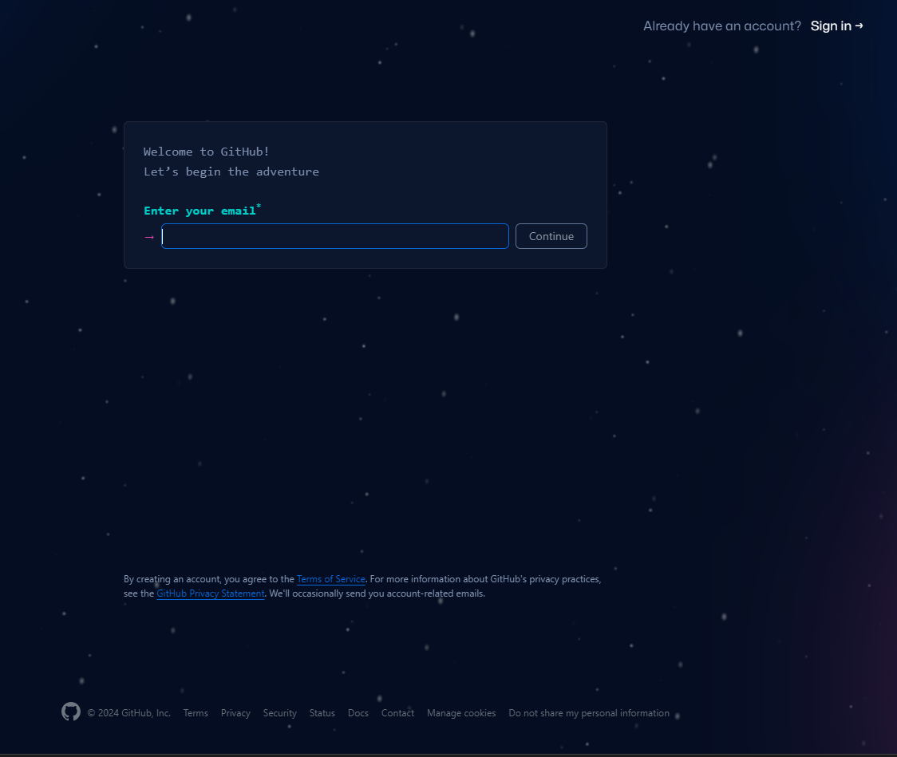
Step 2: Create an account
Go to www.Github.com
Click Sign up
Enter Details
Complete the Creation Process
Go to Home Page

Slide 8
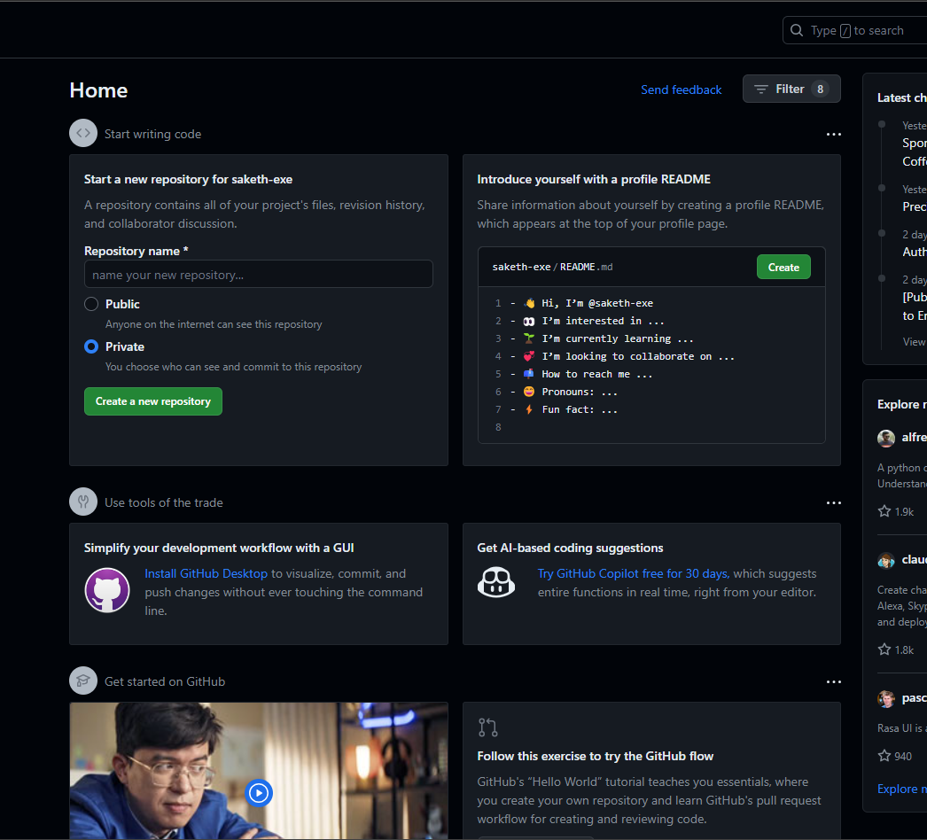
Step 3: Create a new Repository
Enter name of repository
Set public or private
( in public anyone who has your username can see your code while in private you can decide whom to share )
Click on create a new Repository

Slide 9
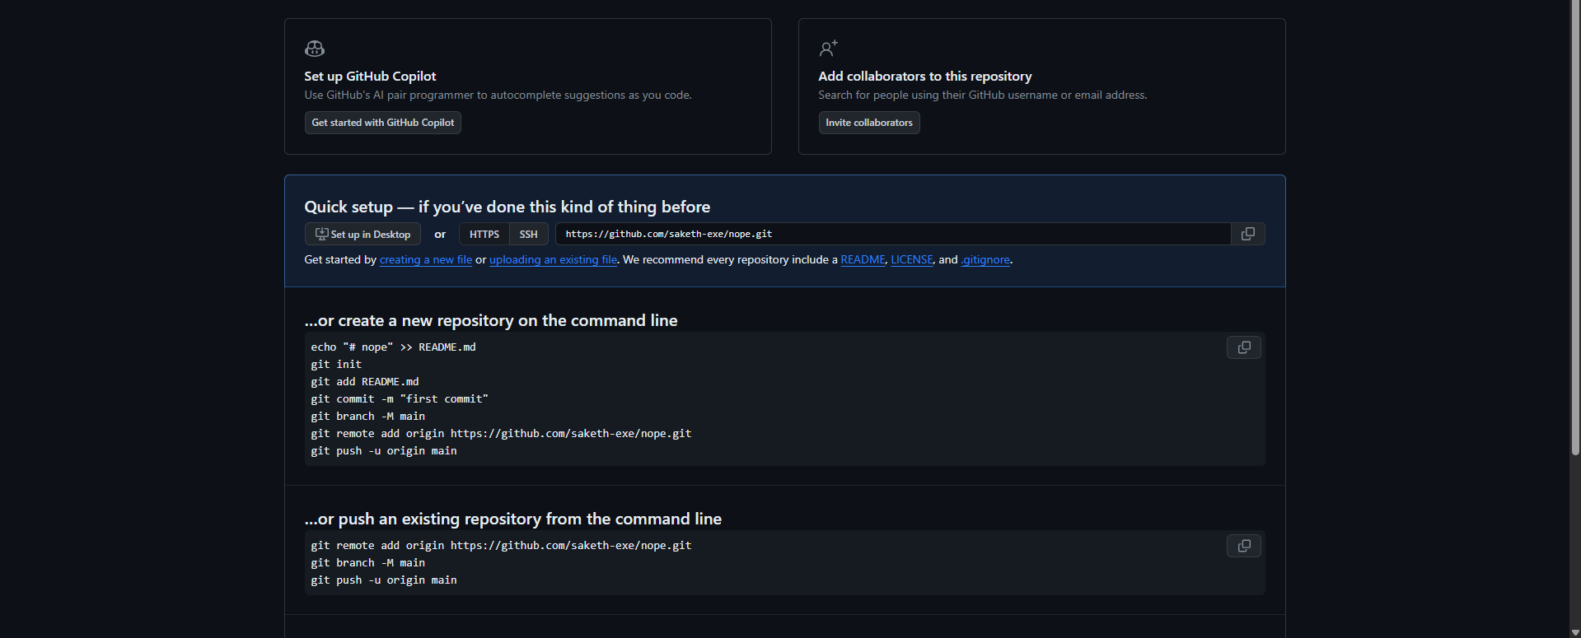
Select this
Copy this
You Should see something like this :

Slide 10
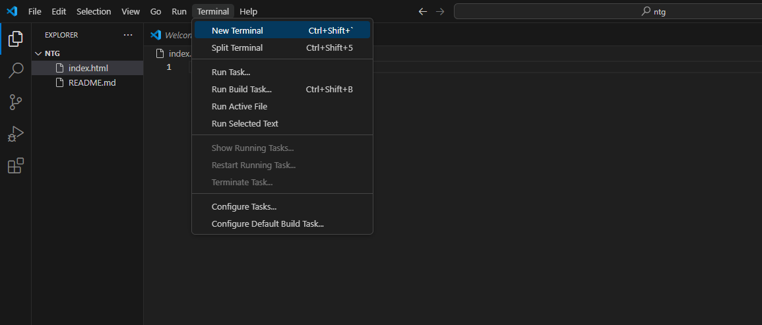
Step 4: Pushing your code
Go to Vscode
Open your html folder
Click new terminal

Slide 11
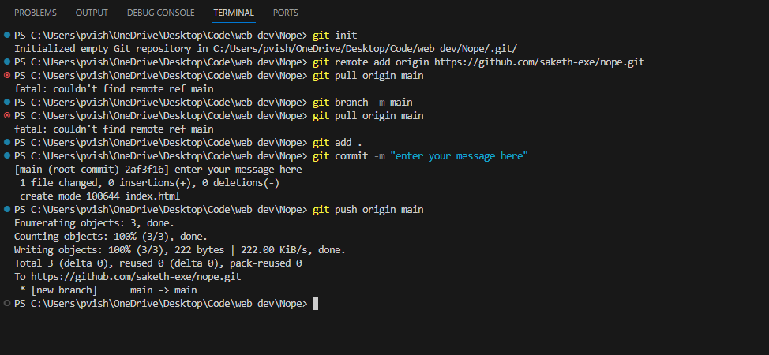

Step 5.1: pushing your code
Paste the like which you have copied
First type "git init"
Then type "git remote add (your url)"
Next , " git branch –m main"
Next , "git add ."
Next, "git commit – m "your message""
Then, "git push origin main"
Can be any message representing why you pushed this code or made changes

Slide 12
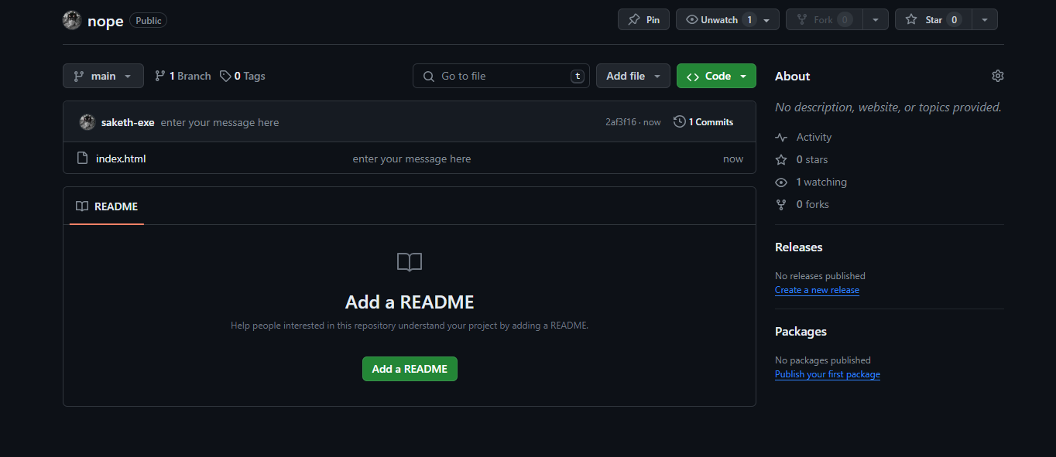
You did it!!
Our file index.html is there in the GitHub
The message you entered in commit command

Slide 13
From next time you make any changes to the code you can use following to push them to GitHub:
git add .
git commit –m " your message"
git push origin main

Slide 14
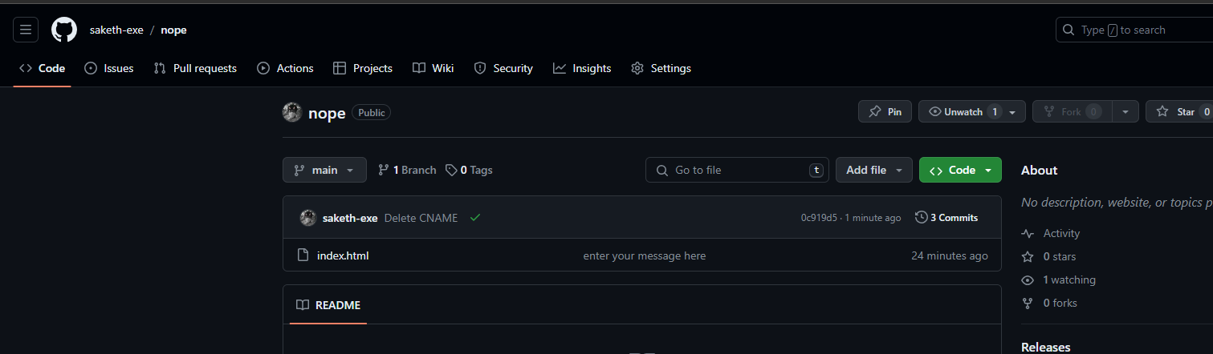
Let's publish your site!! Click on settings on your repo

Slide 15
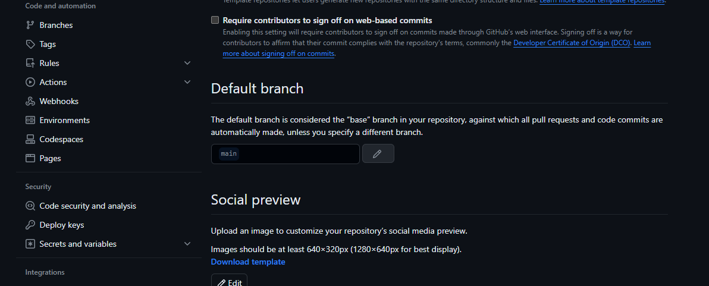
Click Pages

Slide 16
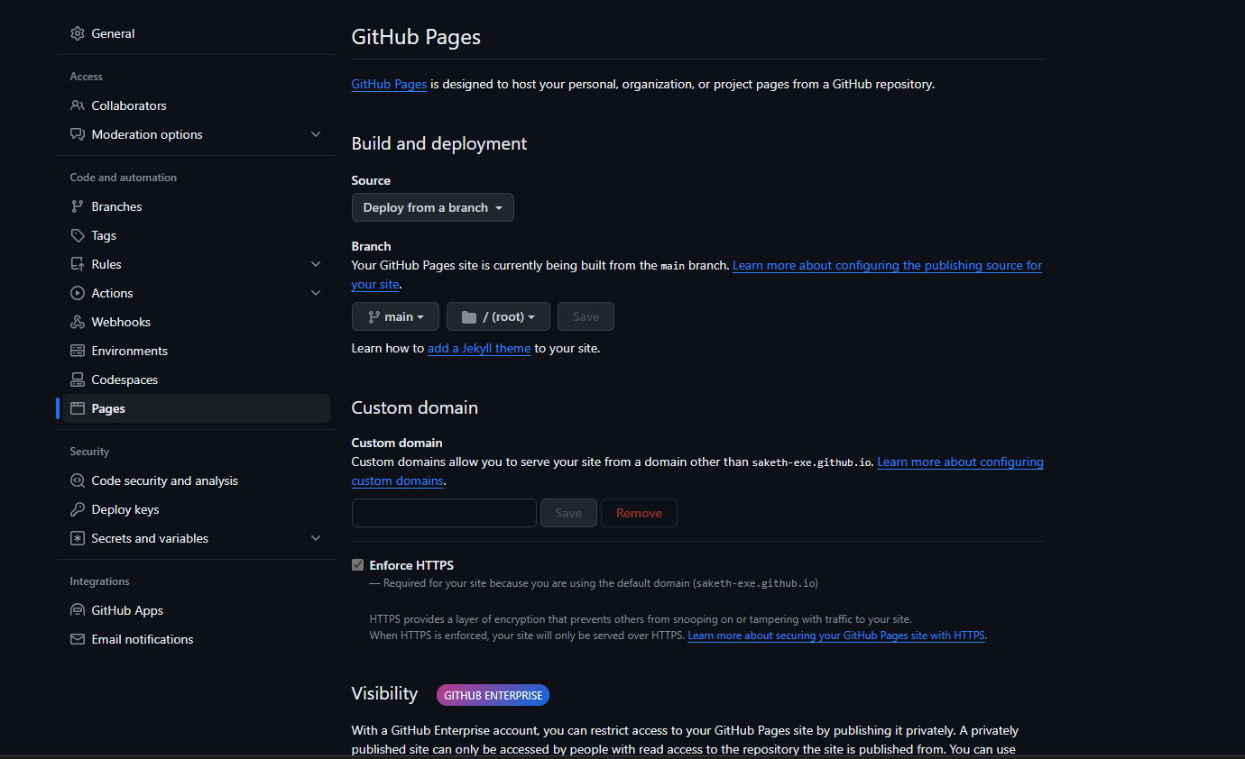
Select source to "Deploy From Branch" Select main branch and click save --> it takes around 2-3 minutes to deploy

Slide 17
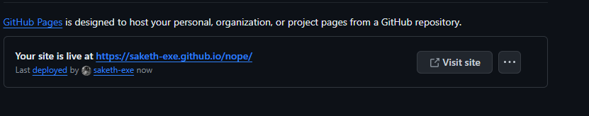
Select source to "Deploy From Branch" Select main branch and click save

Slide 18
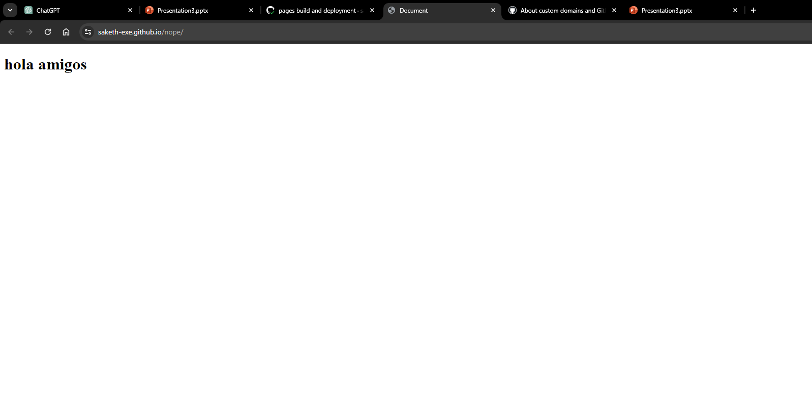

Deployed
Link to your website

Slide 19
Things to remember:
You must make sure the repository is public
Eventually you may run into errors of git
When you make changes to your local website you need to push them to GitHub
Eg : when you publish this and then try to make changes to the file and push it it might not work
For that you need to use
"git fetch origin main"
"git pull origin main"
And then "git push origin main"

Slide 20
References:
https://youtu.be/Ez8F0nW6S-w?si=C6FUz0leNhjWuVH9
For any errors use ChatGPT it is more effective in solving problems like these
There are other commands for version controlling like creating new branchs .etc
All are explained in above video.

Slide 21
Thank You

